Slide 1
Pesented By :- Ku. Roshani Gorde M.Sc-I st (Computer science)
Sant Gadge Baba Amravati University,Amravati.

Slide 2
“Google Glass”

Slide 3
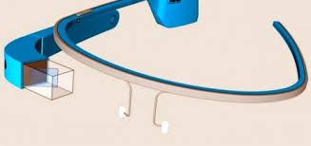
Google Glass

Slide 4
What is Google Glass?
Everyday glass is a useful as a smartphone.
Integrated screen display camera and hidden battery inside the frame.

Slide 5
Google Glass is a wearable,voice controlled anroid device that reassembled a pair of eyeglass and display information directly in the users field of vision.
Users can automatically receives flight status information.
Users can also control the device manually through voice commands and the touchpad located on its frame.

Slide 6
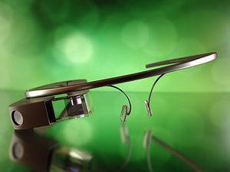
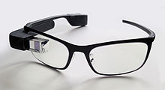
Forms of Google glass

Slide 7
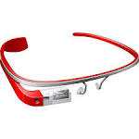

Slide 8
Technology
Half inch display camera(picture and video)
Speaker and microphone.
Bluetooth and Wi-Fi technology.

Slide 9
Features
Voice activated commands.
Hands free live video chat.
360 deg.interactive view.
Mobile maps.

Slide 10
Advantages
The first and foremost advantage of google glass is that it convinience.Users can easily send message without using their hand.
Another option of google glass is that you can capture those amazing moments in a very simple and easy way.

Slide 11
Awards
November 2012, glass received recognition by time magazine as one of the “Best of the year 2012”.

Slide 12
Opinion
Popular in industries and for companies that have lots of video conferencing.
It will sell, but skeptical popularity.
Would change everyday life.

Slide 13
Conclusion
Google glass hopes to be one of the newest and most innovative technology in recent time.
Glass tends to be pioneer into this field in the same way that the iPod was in the electronics music player industry.
Although Google Glass is still in the development process and far from the production phase, there are already numerous of capabilities and applications that could be very useful for consumers, such as live video .

Slide 14
Any Question………?

Slide 15
Thank you…..!

